Slide 1
Object Oriented Programming
Unit I

Slide 2
Objective
To introduce object oriented programming features and its diagrammatic representation of its model components
To understand concept of class, handling its features and the reusability concept in object oriented language.
To understand the mechanism to make use of files and standard libraries.
To introduce the exception handling mechanism and the MVC architecture along with web components to design the software solution.
To introduce how to perform the event driven programming.

Slide 3
Contents
Introduction to object oriented programming paradigm
procedure oriented programming vs OOP
features of OOP
benefits of OOP
defining class
instantiating a class.
UML diagrams to represent class, objects and various relationships.

Slide 4
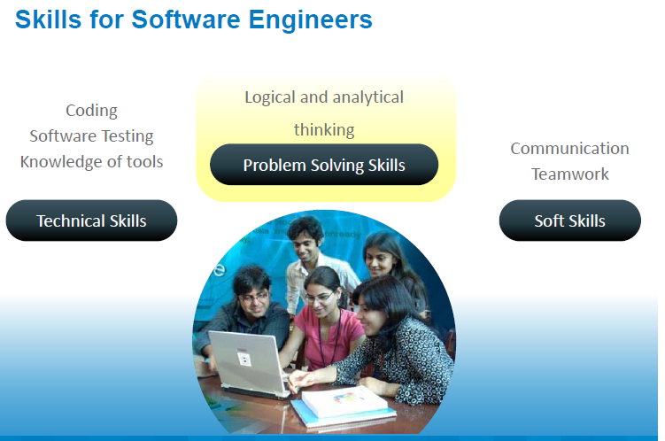

Slide 5
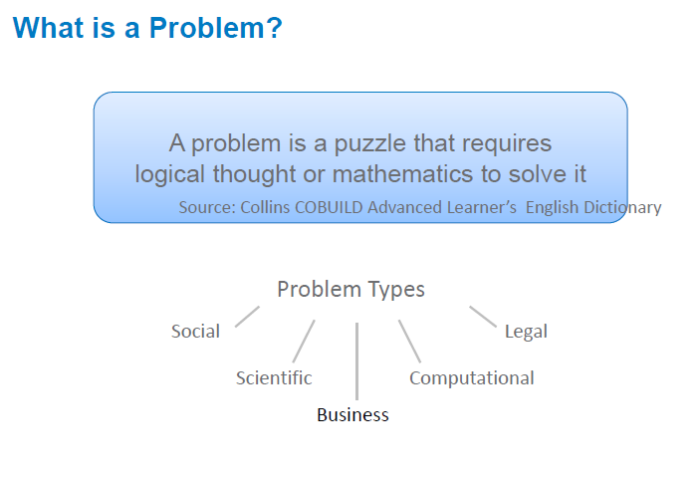

Slide 6
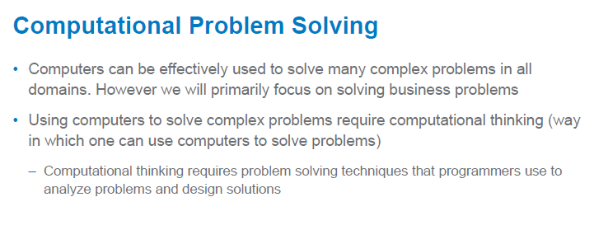

Slide 7
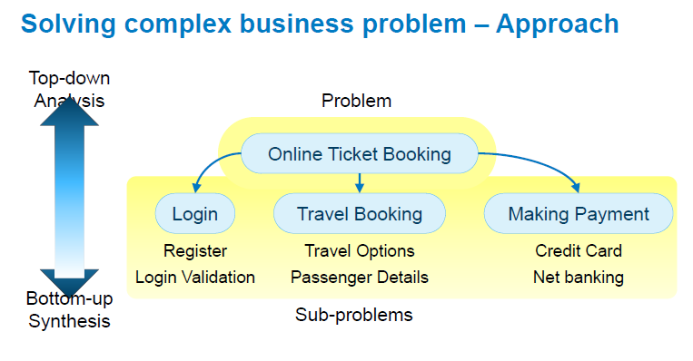

Slide 8
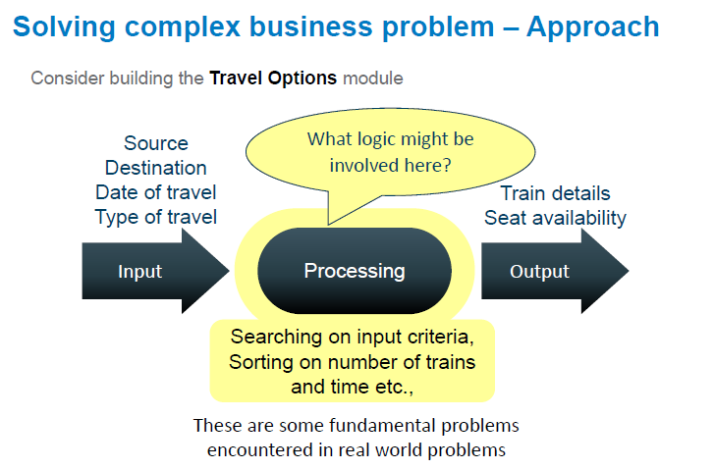

Slide 9
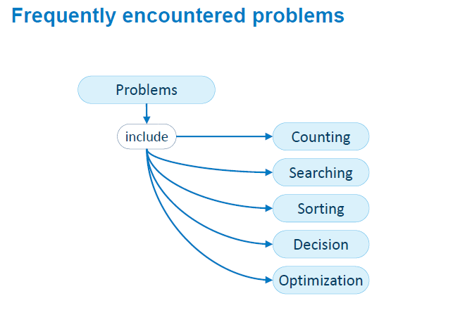

Slide 10
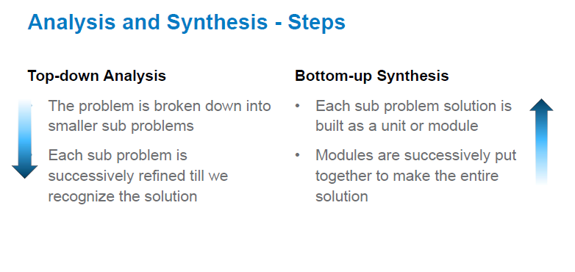

Slide 11
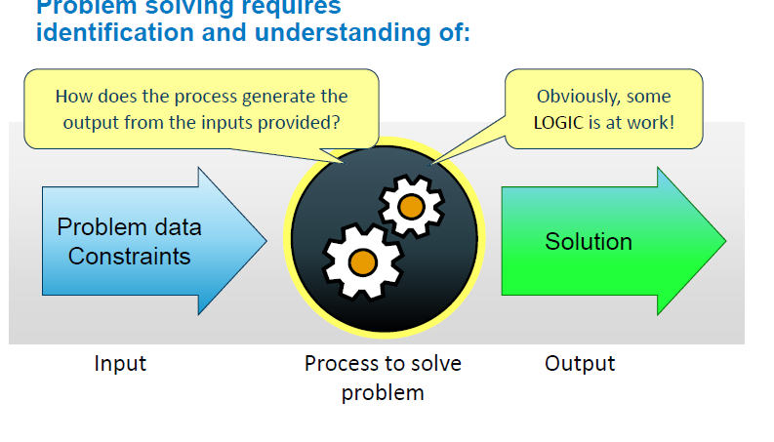

Slide 12
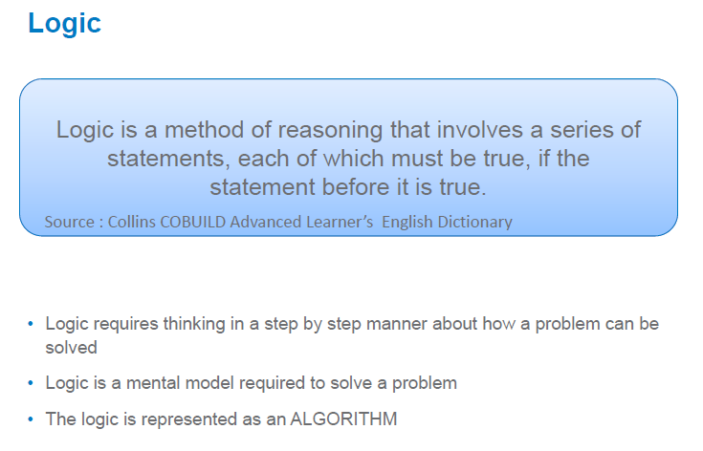

Slide 13
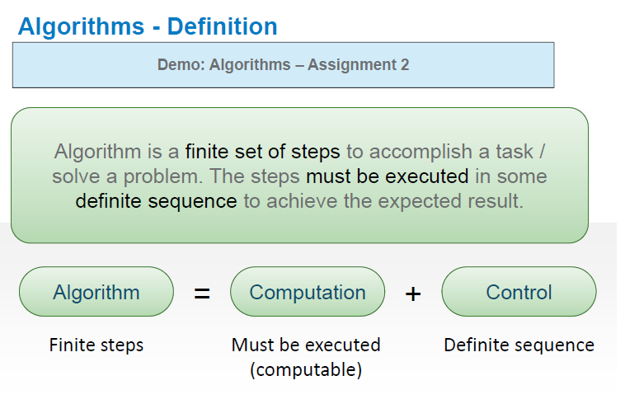

Slide 14
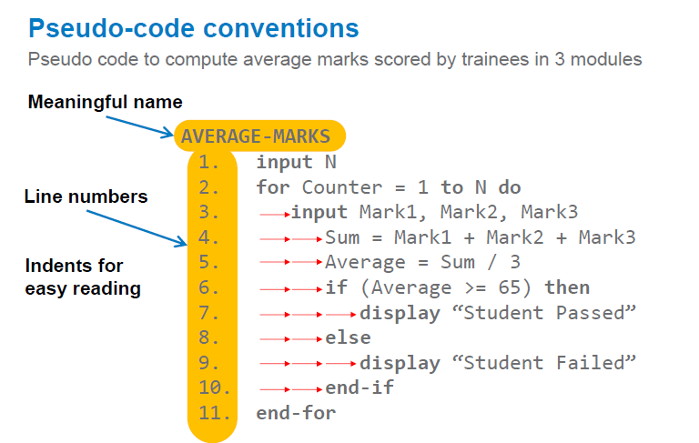

Slide 15
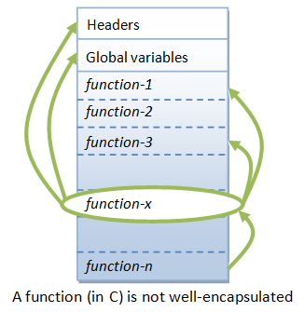
Procedural – oriented languages

Slide 16
The Procedural Paradigm
Operations are separate from data but manipulate it.
Example: A stack data type
Data store (array, linked list)
Separate operations for pushing, popping, etc.

Slide 17
Procedural programming
Emphasis is on doing things
Large programs are divided into smaller programs known as functions
Most of the functions share global data
Data move openly around the system from function to function
Functions transform data from one form to another
Employs top-down approach in program design

Slide 18
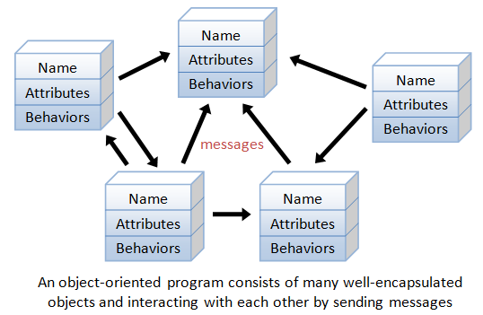
Object oriented language

Slide 19
The Object-Oriented Paradigm
Data is packaged (encapsulated) with the operations that manipulate it.
Example: a stack object
Data store within a stack object
Operations within the stack object

Slide 20
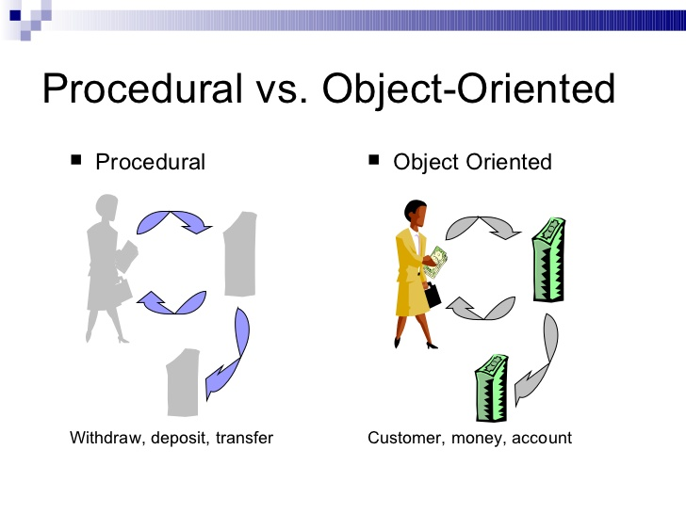

Slide 21
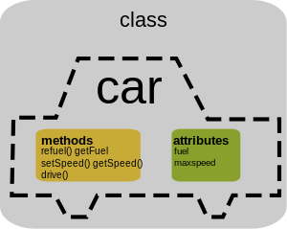

Slide 22
Why is it extensively used?
Well suited for building trivial and complex applications
Allows re-use of code thereby increasing productivity
New features can be easily built into the existing code
Well suited for building trivial and complex applications
Allows re-use of code thereby increasing productivity
New features can be easily built into the existing code
Reduced production cost and maintenance cost
Well suited for building trivial and complex applications
Allows re-use of code thereby increasing productivity
New features can be easily built into the existing code
Reduced production cost and maintenance cost

Slide 23
What is OOP?
Paradigm for problem solving by interaction among objects
It follows a natural way of solving problems
Ex. Priya wants to start her car
(1) Priya walks to her car
(2) Priya sends a message to the car to start by turning on the ignition
(3)The car starts

Slide 24
Object Oriented Programming
Problem: Ann wants to start her car
Object: Priya Object: Priya’s Car
Massage
Name: Priya
Age: 21
Speaks()
Run()
Walk()
Color: White
Brand: Maruti Suzuki
Model: Celerio
Start()
Accelerate()
Stop()

Slide 25
Features of Object oriented programming
Oop treats data as a critical element
It ties data more closely to the functions that operate on it
Data and functions are build around the objects
Data structures are designed such that they characterize the objects
Data is hidden and can not be accessed by external functions
New data and functions can be easily added whenever necessary

Slide 26
Problems with the OO Paradigm
It’s a lot more complicated than the procedural paradigm.
Harder to learn
Harder to use properly

Slide 27
Objects
An object is an entity that has properties and exhibits behavior.
Things are encapsulated when they are packaged together in a container.
Objects encapsulate properties and behavior.
Ideally, objects model things in the world.
Example: Traffic simulation

Slide 28
Attributes and Operations
An attribute is a named data value held by an object or a class.
An operation is a named object or class behavior.
A feature is an attribute or operation.

Slide 29
Attribute and Operation Examples

Slide 30
Object Characteristics
Every object has its own attributes and operations, though these may be the same as some other objects.
Every object has a unique identity.
Two objects with the same attributes holding the same values and behaviors are distinct.

Slide 31
Messages
Objects communicate by sending one another messages.
Messages are abstractions of function calls, signals, exceptions, etc.
Ideally, objects send messages that model real-world communications between things.
Example: Traffic simulation

Slide 32
Classes
An class is an abstraction of a set of objects with common attributes and operations.
Classes have attributes and operations.
A class is not a set of objects—it is more like a blueprint or a specification.
Objects are said to be instances of classes.

Slide 33
A class is a user defined blueprint or prototype from which objects are created
In the real world, you'll often find many individual objects all of the same kind.
There may be thousands of other bicycles in existence, all of the same make and model.
Each bicycle was built from the same set of blueprints and therefore contains the same components.
In object-oriented terms, we say that your bicycle is an instance of the class of objects known as bicycles

Slide 34
Examples of Classes

Slide 35
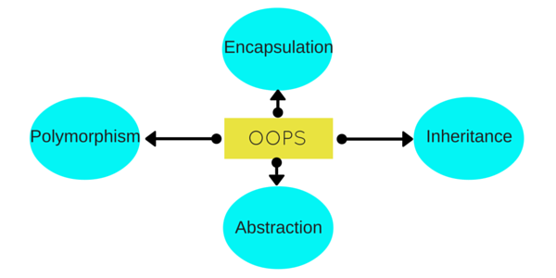
Object oriented programming

Slide 36
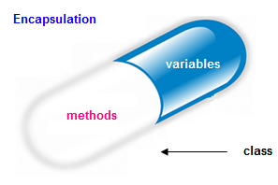
Encapsulation?

Slide 37
Encapsulation
Hide the data from outside world
In c++, encapsulation achieved using the access specifiers (private, public and protected)
By encapsulation we can preventing direct access from outside, and thus have complete control, protection and integrity of the data.

Slide 38
Encapsulation Advantages 1
Problem and solution similarity—Software objects are like real-world things.
Abstraction—Data structures and algorithm details are ignored in design.
Information hiding—Implementations can be truly hidden.
(Shielding the internal details of a program unit’s processing from other program units)

Slide 39
Encapsulation Advantages 2
Coupling—Operations are not related through shared data structures.
(The degree of connection between pairs of modules)
Cohesion—It’s easier to keep related operations and data together.
(The degree to which a module’s parts are related to one another)

Slide 40
Encapsulation Advantages 3
Reusability—It’s easier to reuse objects than collections of operations and various data structures.
Scalability—Objects can be of arbitrary size.
New features—The object-oriented paradigm offers new and powerful ways of doing things, as we will see.

Slide 41
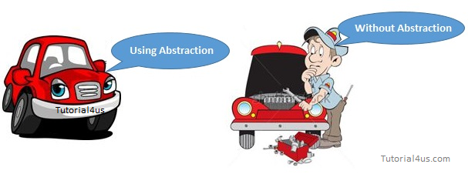
Abstraction?

Slide 42
Data Abstraction
Data abstraction refers to hiding the internal implementations and show only the necessary details to the outside world.
In C++ data abstraction is implemented using interfaces and abstract classes.

Slide 43
Inheritance Why inheritance should be used?
Suppose, in your game, you want three characters - a maths teacher, a footballer and a businessman.
Since, all of the characters are persons, they can walk and talk. However, they also have some special skills. A maths teacher can teach maths, a footballer can play football and a businessman can run a business.
You can individually create three classes who can walk, talk and perform their special skill

Slide 44
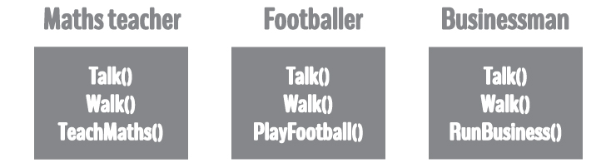
Why inheritance should be used?
In each of the classes, you would be copying the same code for walk and talk for each character.
If you want to add a new feature - eat, you need to implement the same code for each character. This can easily become error prone (when copying) and duplicate codes.

Slide 45
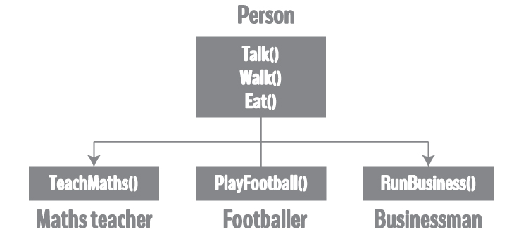
Solution?
Parent class
Base class
Child class
Sub class
Derived class

Slide 46
Polymorphism
The process of representing one Form in multiple forms is known as Polymorphism.
Original form or original method always resides in base class and multiple forms represents overridden method which resides in derived classes.
Typically, polymorphism occurs when there is a hierarchy of classes and they are related by inheritance

Slide 47
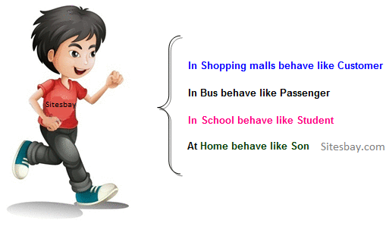
Example of polymorphism

Slide 48
Polymorphism in programming
In programming languages, polymorphism means that some code or operations or objects behave differently in different contexts
For Example, the +(plus) operator in C++
4 + 5 ← Integer addition
3.14 + 2.0 ← Floating point addition
S1 + “bar” ← String concatenation // “p” + “d” = pd

Slide 49
Advantages of OOP
Code Reuse and Recycling: Objects created for Object Oriented Programs can easily be reused in other programs.
Encapsulation (part 1): Once an Object is created, knowledge of its implementation is not necessary for its use. In older programs, coders needed understand the details of a piece of code before using it
Encapsulation (part 2): Objects have the ability to hide certain parts of themselves from programmers. This prevents programmers from tampering with values they shouldn't.
Design Benefits: Large programs are very difficult to write. Object Oriented Programs force designers to go through an extensive planning phase, which makes for better designs with less flaws.
Software Maintenance: Programs are not disposable. Legacy code must be dealt with on a daily basis, either to be improved upon (for a new version of an exist piece of software) or made to work with newer computers and software.

Slide 50
Procedure oriented programming VS OOP
 | Procedure Oriented Programming | Object Oriented Programming
Divided Into | In POP, program is divided into small parts called functions. | In OOP, program is divided into parts called objects.
Importance | In POP,Importance is not given to data but to functions as well as sequence of actions to be done. | In OOP, Importance is given to the data rather than procedures or functions because it works as a real world.
Approach | POP follows Top Down approach. | OOP follows Bottom Up approach.
Access Specifiers | POP does not have any access specifier. | OOP has access specifiers named Public, Private, Protected, etc.
Data Moving | In POP, Data can move freely from function to function in the system. | In OOP, objects can move and communicate with each other through member functions.
Expansion | To add new data and function in POP is not so easy. | OOP provides an easy way to add new data and function.
Data Access | In POP, Most function uses Global data for sharing that can be accessed freely from function to function in the system. | In OOP, data can not move easily from function to function,it can be kept public or private so we can control the access of data.
Data Hiding | POP does not have any proper way for hiding data so it is less secure. | OOP provides Data Hiding so provides more security.
Overloading | In POP, Overloading is not possible. | In OOP, overloading is possible in the form of Function Overloading and Operator Overloading.
Examples | Example of POP are : C, VB, FORTRAN, Pascal. | Example of OOP are : C++, JAVA, VB.NET, C#.NET.

Slide 51
Class identification
customer_name customer item_id description bill_amount price_per_unit item pays_bill purchases employee designation

Slide 52
Ex. 1
add() // implementation
{
int y = 0; // local variable
int sum = x +y;
----
}
add()
{
String a = “name”, b=“surname”;
String fn = a.concat(b);
}
sub() //abstraction
}

Slide 53
Java Object
className object = new className();
MyClass o1; // declaration of object
o1=new MyClass(); //creation or instantiation of object

Slide 54
How to access members?
//signature of the method, name, parameters, return
abc() //header part
{
}

Slide 55
A class can contain any of the following variable types
{
Vkdsfnkdsfkl
Skdfkldsjf
mfmsdf
}
Local variables − Variables defined inside methods, constructors or blocks are called local variables. The variable will be declared and initialized within the method and the variable will be destroyed when the method has completed.
Instance variables − Instance variables are variables within a class but outside any method. These variables are initialized when the class is instantiated. Instance variables can be accessed from inside any method, constructor or blocks of that particular class.
Class variables − Class variables are variables declared within a class, outside any method, with the static keyword.

Slide 56
Creating an Object
In Java, the new keyword is used to create new objects.
There are three steps when creating an object from a class −
Declaration − A variable declaration with a variable name with an object type.
Instantiation − The 'new' keyword is used to create the object.
Initialization − The 'new' keyword is followed by a call to a constructor. This call initializes the new object.

Slide 57
Source File Declaration Rules
These rules are essential when declaring classes, import statements and package statements in a source file.
There can be only one public class per source file.
A source file can have multiple non-public classes.
The public class name should be the name of the source file as well which should be appended by .java at the end. For example: the class name is public class Employee{} then the source file should be as Employee.java.
If the class is defined inside a package, then the package statement should be the first statement in the source file.
If import statements are present, then they must be written between the package statement and the class declaration. If there are no package statements, then the import statement should be the first line in the source file.
Import and package statements will imply to all the classes present in the source file. It is not possible to declare different import and/or package statements to different classes in the source file.

Slide 58
Encapsulation
Data and methods are combined (secure) class
Abstraction
Display only required functionality (implement)
Inheritance
Inherit or use the common features (methods and data) from the parent class
Implementation of the common features is in the parent class
Polymorphism
One functionality having different implementation (eg. Person, student, customer, son, passenger)

